Slide 1

EEG-Based Brain–Computer Interface Controlling a Robotic Arm
CASE STUDY ASSISTIVE ROBOTICS FOR IMPROVEMENT OF LIFE QUALITY(SS26)
MASTER'S ROBOTICS COURSE
Prajwal Dikonda
Nishant Shetty
Matriculation Number : 22516691
Matriculation Number : 22566540
Papiha Dhavan
Matriculation Number : 22514341

Slide 2

Project Overview
This project bridges the gap between neural intent and physical action — enabling a robotic arm to be controlled entirely through brain signals, without any physical movement.
EEG Signal Acquisition
Raw electroencephalography signals are captured from the scalp during motor imagery tasks.
Signal Processing & Classification
Signals are filtered, features extracted, and classified into discrete movement commands.
Robotic Arm Control
Classified commands drive a multi-DOF robotic arm for assistive, real-world tasks.

Slide 3

Problem Statement
Paralysis severs the link between brain and body — yet the brain's intention to move remains intact. Individuals with motor disabilities struggle with fundamental daily tasks: grasping objects, reaching, and holding.
5M+
Living with Paralysis
In the United States alone
15M
Strokes per Year
Global estimate (WHO)
Motor cortex activity persists even after injury — BCI systems can decode this latent intent.

Slide 4

Motivation
Restore Independence
Empower individuals to perform daily tasks without reliance on a caregiver or physical assistance.
Reduce Caregiver Dependency
Lower the social and economic burden on families and healthcare systems by enabling self-sufficiency.
Growing Demand
An ageing global population and rising stroke incidence create urgent need for scalable assistive solutions.

Slide 5
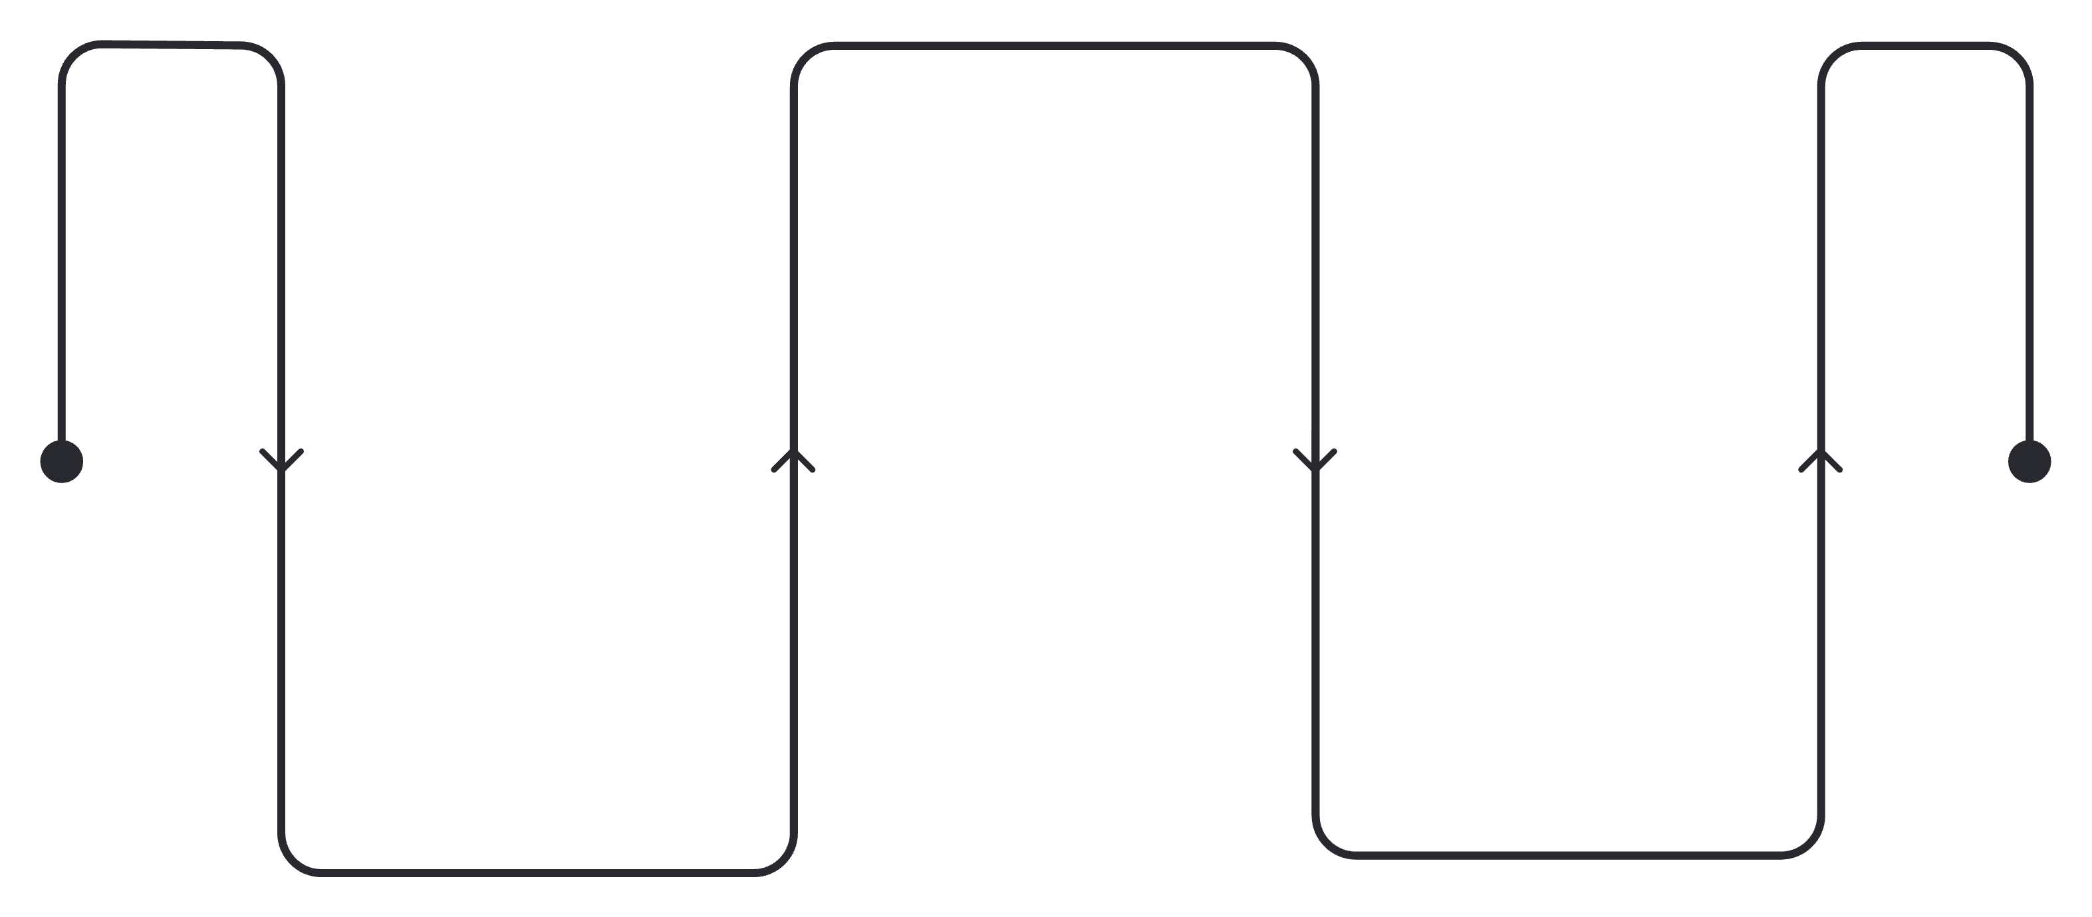
Proposed Solution
An EEG-based Brain–Computer Interface (BCI) that decodes motor imagery signals and maps them to discrete robotic arm commands — enabling real-time, hands-free control.
BCI Processing
Filter, extract, classify
Brain
Robotic Arm
EEG motor imagery signals
Reach, grasp, move
The pipeline is designed to be lightweight, modular, and extendable — suitable for real-time embedded deployment on assistive hardware.

Slide 6
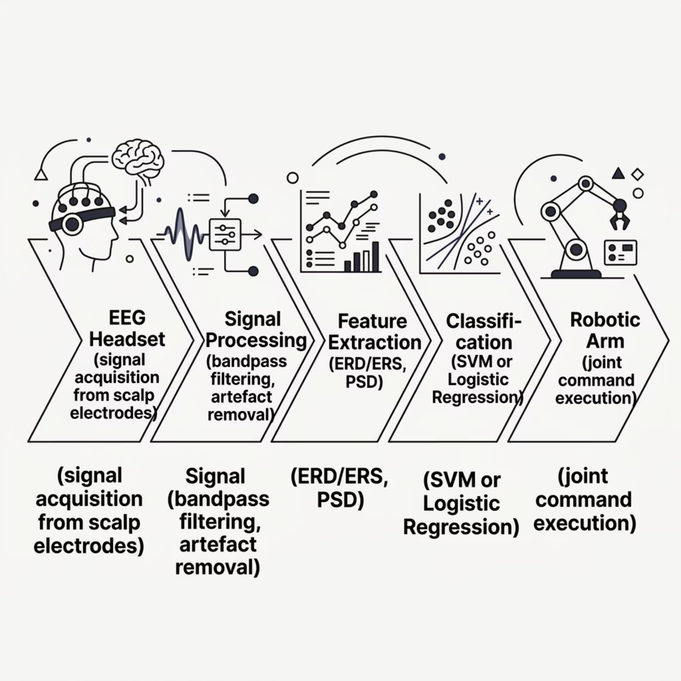

System Architecture
Pipeline Stages
EEG Acquisition: Motor imagery captured via scalp electrodes
Preprocessing: Bandpass filtering (8–30 Hz), artefact removal
Feature Extraction: ERD/ERS patterns, power spectral density
Classification: SVM or Logistic Regression decoder
Command Execution: Mapped to robotic joint movements

Slide 7
Methodology
EEG Data Acquisition
Signal Preprocessing
Motor imagery dataset (e.g., BCI Competition IV) or a physical EEG headset used for signal capture.
Bandpass filtering (8–30 Hz) removes noise; ICA eliminates ocular and muscular artefacts.
Feature Extraction
Classification & Command Mapping
Event-related desynchronisation (ERD) and power spectral density computed per trial window.
SVM or Logistic Regression classifies intent; output is mapped to one of seven arm movement commands.

Slide 8

Robotic Arm Movements
Seven essential degrees of freedom enable a full repertoire of daily assistive tasks — from reaching to object manipulation.
Base Rotation
Forward Reach
Backward Retract
Left / Right
Extend toward object
Return to home position
Elbow Flex
Wrist Rotation
Gripper Open
Up / Down
Palm supination / pronation
Release object
Gripper Close
Grasp object
These movements collectively enable basic daily tasks such as reaching, grasping, and transporting objects.

Slide 9

Impact & Applications
Immediate Benefits
Future Extensions
Enables people with motor disabilities to perform daily tasks independently
Hands-free, non-invasive neural control where no physical movement required
Directly improves quality of life and reduces social isolation
Prosthetics: Neuroprosthetic limb replacement
Exoskeletons: Full-body motor rehabilitation support
Teleoperation: Remote control in hazardous environments
Closed-loop BCI: Haptic feedback integration for richer control

Slide 10
Conclusion
Brain-controlled robotic systems represent a meaningful step forward in assistive technology — restoring agency to those the body can no longer serve.
What We Demonstrated
Why It Matters
Next Steps
A complete, end-to-end EEG-BCI pipeline — from signal acquisition through classification to robotic arm control.
The approach is non-invasive, modular, and scalable — accessible to both clinical and research settings.
Real-time EEG hardware integration, closed-loop feedback, and expanded motor imagery class vocabulary.

Slide 11
Conclusion & References
Key Takeaways
References
Proof of Concept
World Health Organization – Stroke and neurological disorder global statistics
United Nations – World Population Ageing Report
EEG-based BCI demonstrates a viable, non-invasive pathway from neural intent to robotic action.
Centers for Disease Control and Prevention – Disability and paralysis prevalence data
Christopher & Dana Reeve Foundation – Paralysis statistics
Scalable & Modular
Each pipeline stage is independently upgradeable — from better classifiers to more DoF robotic arms.
National Institute on Aging (NIA) – Ageing and daily living assistance
Clinically Meaningful
Directly addresses an unmet need for millions of individuals living with paralysis worldwide.

